Slide 1
Social media and businesses
Abhimanyu Shankhdhar

Slide 2
Table of contents
The facilitator……………………………………………………..3
Introduction to social media………………………….......4
Social media & business adoption……………………….5
Social media for business functions…………………….6
Social media for effective leadership….…..…………..7
Top social networks for business………….……….......8
Blogging and content marketing………………………….9
Social media and ROI – is it real?.………………………10
Social media and ROI – how?.................................11
Social media ROI – some examples…………………….12
Questions…………………………………………………………...13

Slide 3
Introduction to social media
<Start with video>
Some other important facts for businesses:
36% of all social media users have posted about a brand or product at some point of time
61% of all social media users are willing to give feedback about brands on social networks
42% of social media users have had at least one direct conversation with a brand on social networks
85% of users were never contacted by a company or brand despite posting a negative review about it
82% of these people stopped doing business with the brand in question as a result
Source: InSites Study 2012

Slide 4
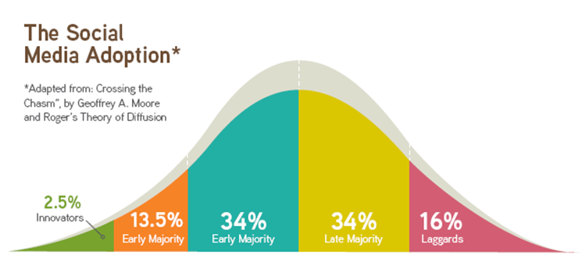
Social media & business adoption
The ones who discover and trendify
The earliest adopters after discovery
Those who will ‘wait and see’ before adopting
The last ones to adopt a new technology
Might never get around to adopting it

Slide 5
Social media for business functions
Marketing – The most obvious and common use of social media in business. Works because almost every brand has a section of target audience online today
HR – Great for identifying and engaging with talent directly. Also enables companies to showcase employee benefits and culture to outside world
Creative – Sharing enables art, copy and design teams to get new ideas, learn new things and experiment
Operations / Strategy – Sites like LinkedIn help in connecting with domain experts who can share valuable strategic insights
Business Development – B2B companies can use professional networking sites to connect with prospective clients

Slide 6
Social media for leadership
Visibility – in the industry, among peers and team members
Reputation – Use of social media builds a CxO reputation as a progressive, fearless and confident leader
Approachability – For clients and team members, a CxO active on social media is a sign of an approachable and transparent company
Thought leadership – Needless to say, being active on social media will mean a lot of strong content, and that will recognise the CxO as a thought leader
Good for business – A leader who is seen positively on social media will help the business through his personal brand

Slide 7
Top social networks for business
Facebook – Highest advertising revenue of all social media sites; ideal for FMCG, lifestyle, apparel and luxury brands to build presence and advertise on
Twitter – Favorite rant corner for most consumers; micro blogging feature takes away the pressure to be compelling or grammatically correct
LinekdIn – Must for serious businesses and companies looking to mine data, manage knowledge or be ‘thought leaders’
Blog – Still in flavor for serious or lengthier communication; great for SEO
Pintrest – Ideal for a design, art and pre media agencies

Slide 8
Importance of blogs and content
Content is still the king – Even as text gives way to audio visual
Huge factor in searchability – A good, well marketed blog can save a lot of money otherwise paid to an SEO company
Data and knowledge management – through external and internal blogs, companies can create domain experts and share knowledge with clients, peers and employees
Thought leadership – Again, a good blog with meaty content positions you as a leader in the domain

Slide 9
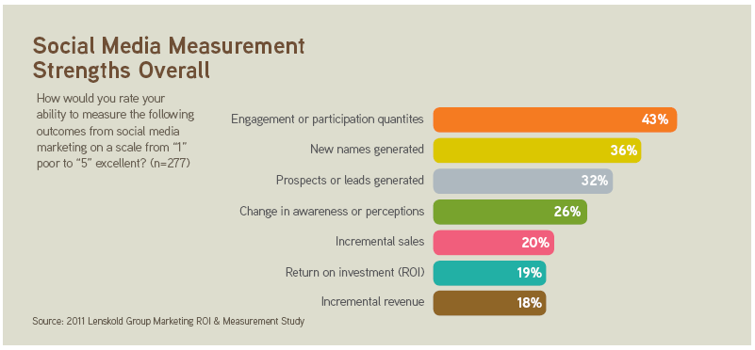
Social media and ROI – is it real?
What’s the ROI of your pants? Your phone? Your secretary?
Only 19% of all marketers using social media are able to calculate ROI

Slide 10
Social media and ROI – how?
Important to differentiate between ROI and metrics
10000 hits to a website is a metric, not an ROI
Increase in customer satisfaction by 15 points is also not ROI
ROI = Benefits – Cost x 100
Cost
To measure benefits, conduct surveys and research post social media implementation and assess impact through questions like:
Did you attend our show / purchase our coupons / buy our shoes?
Where did you hear about us?
Use this data to calculate ROI

Slide 11
Social media and ROI – examples
Positive
Dell - $6.5 M in sales via Twitter
Old spice – Increase in sales by 107%
Jet Airways – Huge PR resulting into customer loyalty and repeat sales
Sea World San Antonio – 5800% ROI (using the ROI formula on prev page)
Negative
Dominos ‘dirty food’- Sales down by 30%
Gap logo change – Sales went down in two weeks
United Airlines ‘breaks guitars’ – $1.6 M losses in ticket sales

Slide 12
Questions?

